Slide 1

离散数学
Discrete Mathematics
钟芳明
离散数学
Discrete Mathematics

Slide 2
Review
Duality principle
Definition
Three theorems：Negation operation and duality, equivalence, tautological implication
Disjunctive and Conjunctive normal form
Elementary product, elementary sum
Product of elementary sum, sum of elementary product
Principal disjunctive and conjunctive normal form
Minterm (product), Maxterm (sum)，Base—binary number—decimal number—descriptor
Sum of minterms, product of maxterms, their relations.
Used in finite steps to determine the formula type. (tautology, contradiction, contingency)
2

Slide 3
Review
Procedures of finding (principal) normal form：
(1) Eliminating connectives
(2) Eliminating negation.
(3) Using distributive law.
(4) Add missing variables.
Q⇔T ∧ Q⇔(P ∨ ¬P) ∧ Q⇔(P ∧ Q) ∨(¬P ∧ Q)
Q⇔F ∨ Q⇔(P ∧ ¬P) ∨ Q⇔(P ∨ Q) ∧(¬P ∨ Q)

Slide 4
Chapter 1 Propositional Logic
1.7 Reasoning with propositional logic

Slide 5
Reasoning with propositional logic
有效结论
定义
证明方法：
1.真值表法
2.直接证明
推论规则
P、T
CP
3.反证法
F规则
One of the main tasks of mathematical logic is reasoning.
The process of reasoning from one or more premises to reach logically conclusions is called deduction or proof.
In real life：
Given the true premise, if the argument that derives a conclusion from a premise follows the rules of logical reasoning, the conclusion is also true . And that the argument is legitimate。
In mathematical logic：
Without caring about the truth of the premises, we focus on the research of inference rules（推理规则）, and any conclusion based on these inference rules is called valid conclusion(有效结论). This kind of argument is called a valid argument(有效论证).

Slide 6
Valid conclusion
有效结论
定义
证明方法：
1.真值表法
2.直接证明
推论规则
P、T
CP
3.反证法
F规则
Definition: A and B are propositional formulas, when and only when A→B is tautological true, namely A⇒B, B is a valid conclusion of A, or B can be derived from A logically.
This definition can be extend to the condition with n premises。

Slide 7
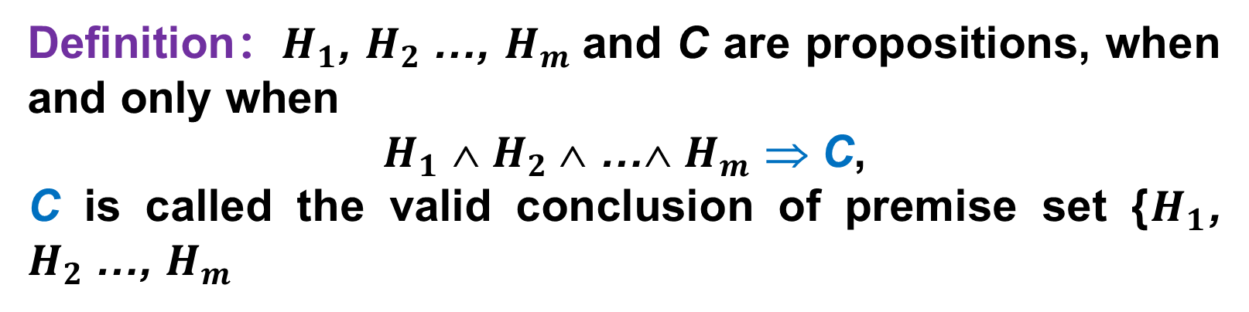
Valid conclusion
有效结论
定义
证明方法：
1.真值表法
2.直接证明
推论规则
P、T
CP
3.反证法
F规则
Definition：$H_{1}$, $H_{2}$…, $H_{m}$and C are propositions, when and only when
$H_{1}$ ∧ $H_{2}$∧ …∧ $H_{m}$ ⇒ C,
C is called the valid conclusion of premise set {$H_{1}$, $H_{2}$…, $H_{m}$
Example：
H₁：Today is Monday or it is raining today.
H₂：Today is not Monday.
C：It is raining today.

Slide 8
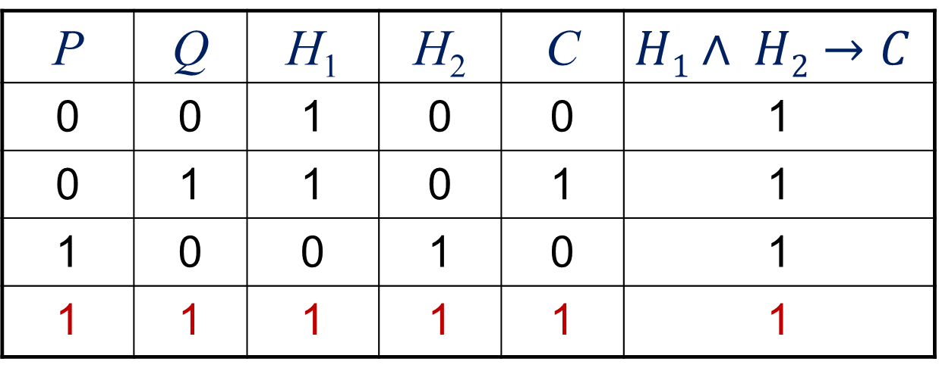
Methods to prove valid conclusion
有效结论
定义
证明方法：
1.真值表法
2.直接证明
推论规则
P、T
CP
3.反证法
F规则
1. Truth table
“the true assignments, which make all premises true, also make the conclusion true”
Example: Whether C is the conclusion of the following premises H₁，H_{2.}
(1) H₁：P→Q，H₂：P，C：Q
P | Q | H₁ | H₂ | C | $$H1∧ H2→C$$
0 | 0 | 1 | 0 | 0 | 1
0 | 1 | 1 | 0 | 1 | 1
1 | 0 | 0 | 1 | 0 | 1
1 | 1 | 1 | 1 | 1 | 1

Slide 9
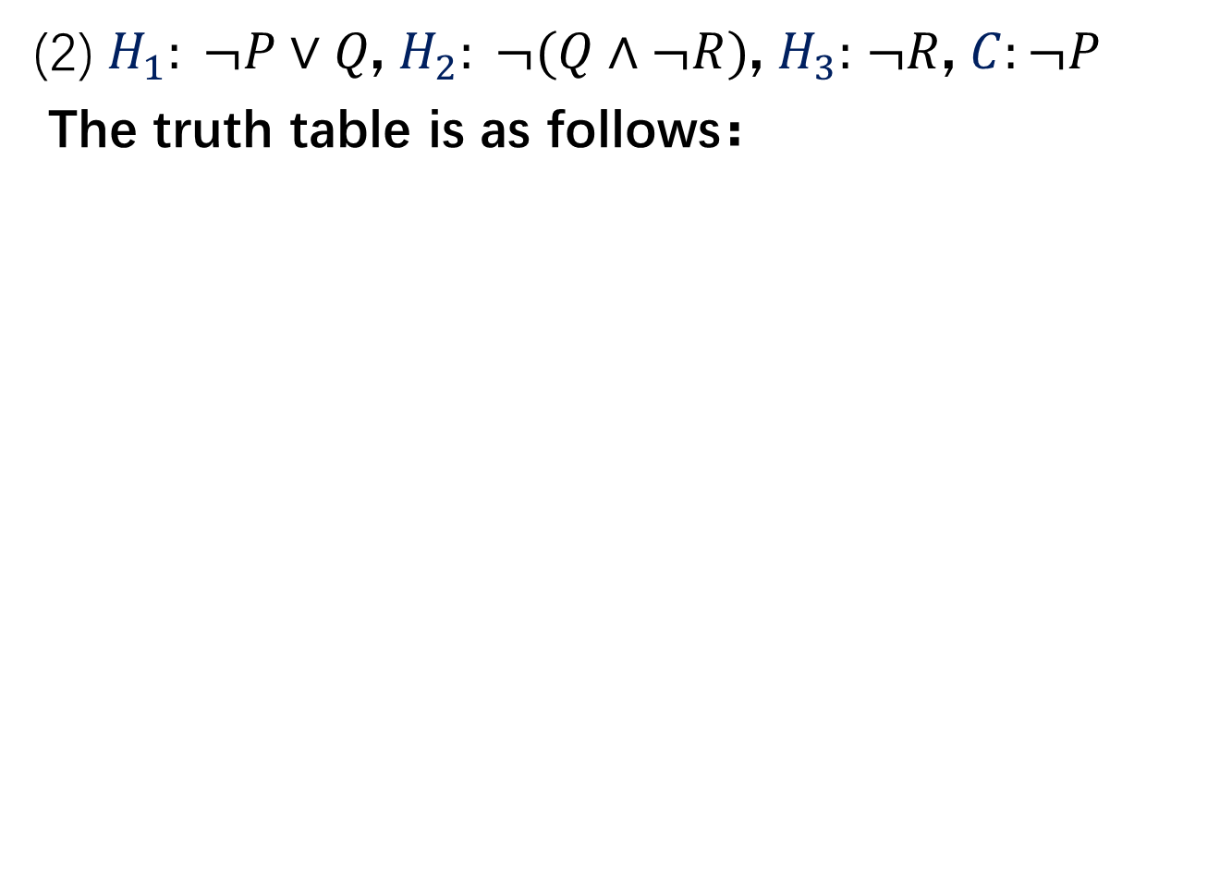
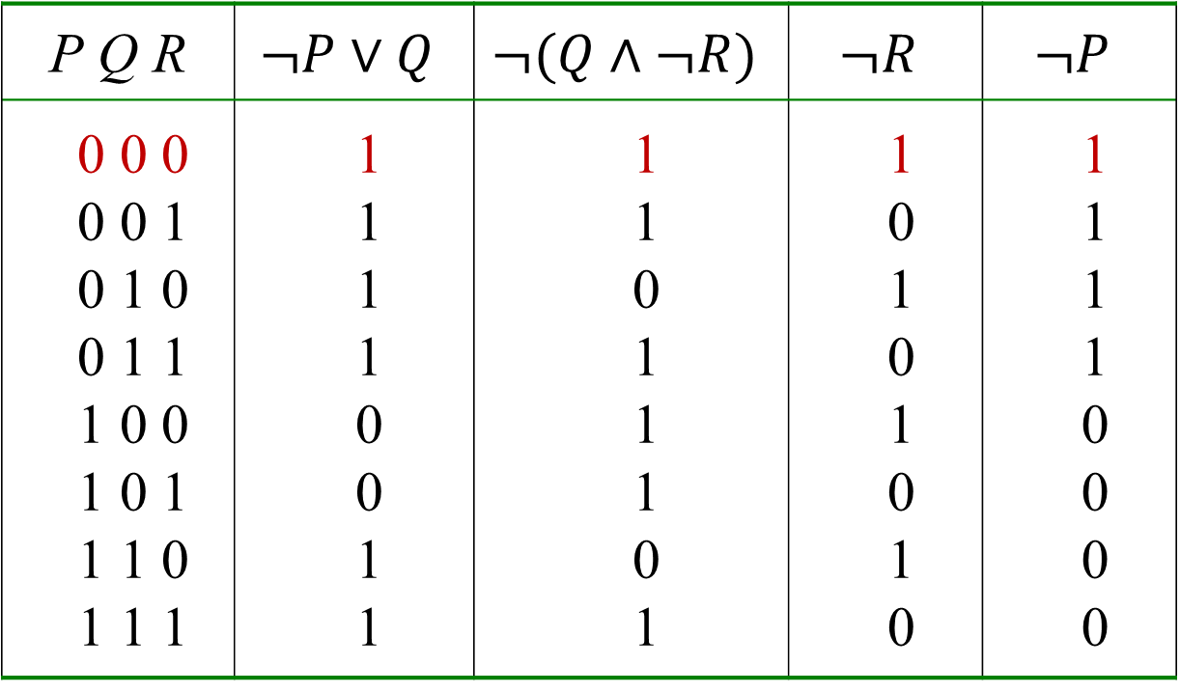
Method of truth table
有效结论
定义
证明方法：
1.真值表法
2.直接证明
推论规则
P、T
CP
3.反证法
F规则
(2) $H_{1}: ¬P∨Q$, $H_{2}: ¬(Q∧¬R)$, $H_{3}:$ $¬R$, $C:¬P$
The truth table is as follows：
P Q R | $$¬P∨Q$$ | $$¬(Q∧¬R)$$ | $$¬R$$ | $$¬P$$
0 0 0 0 0 1 0 1 0 0 1 1 1 0 0 1 0 1 1 1 0 1 1 1 | 1 1 1 1 0 0 1 1 | 1 1 0 1 1 1 0 1 | 1 0 1 0 1 0 1 0 | 1 1 1 1 0 0 0 0

Slide 10
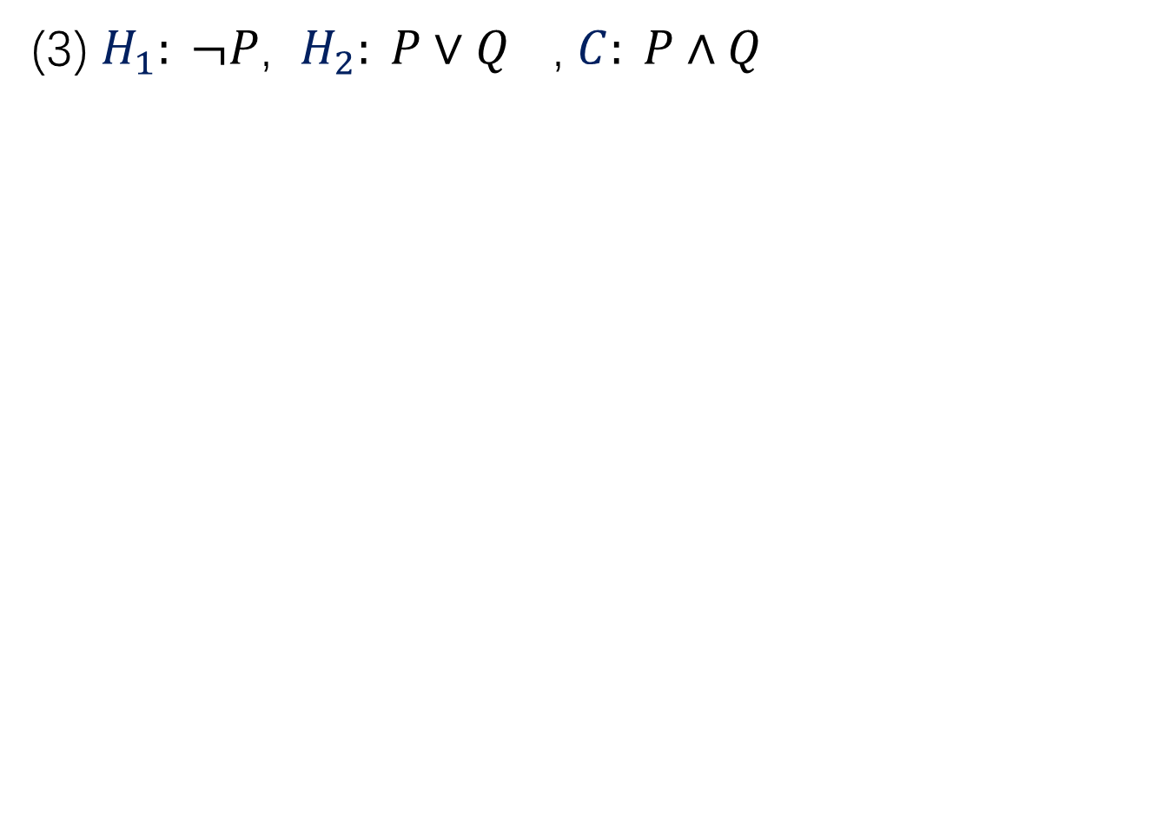
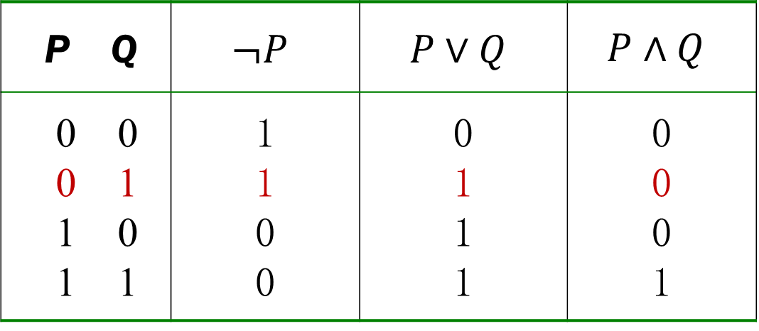
Method of truth table
有效结论
定义
证明方法：
1.真值表法
2.直接证明
推论规则
P、T
CP
3.反证法
F规则
(3) $H_{1}: ¬P$, $H_{2}: P∨Q$ , $C: P∧Q$
P Q | $$¬P$$ | $$P∨Q$$ | $$P∧Q$$
0 0 0 1 1 0 1 1 | 1 1 0 0 | 0 1 1 1 | 0 0 0 1

Slide 11
Method of truth table
有效结论
定义
证明方法：
1.真值表法
2.直接证明
推论规则
P、T
CP
3.反证法
F规则
Example：An error in a statistical table is due to unreliable materials or an error in calculation; The error in this statistical table is not due to unreliable materials, so it is due to calculation errors
Solution：
P: An error in a statistical table is due to unreliable materials.
Q: An error in a statistical table is due to calculation errors.
So the problem can be symbolized as：
(P∨Q)∧¬P⇒Q

Slide 12
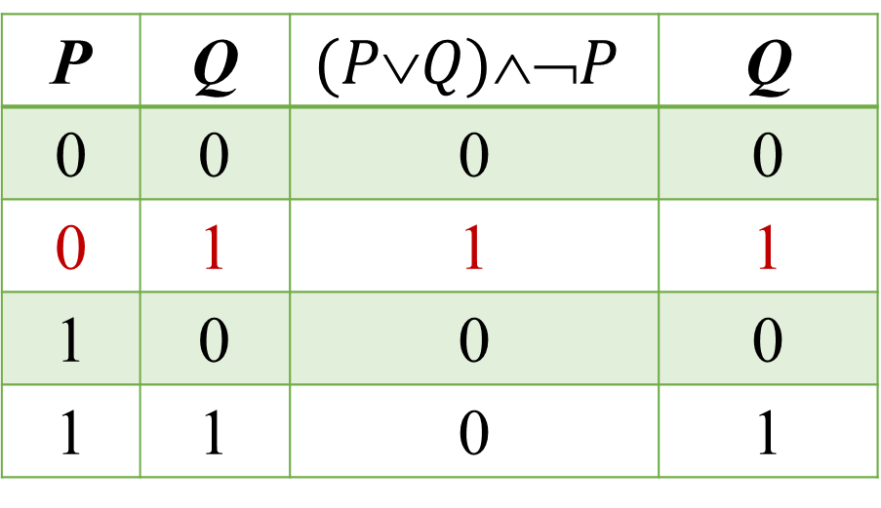

Method of truth table
有效结论
定义
证明方法：
1.真值表法
2.直接证明
推论规则
P、T
CP
3.反证法
F规则
$$(PQ)➢PQ$$
P | Q | $$(PQ)➢P$$ | Q
0 | 0 | 0 | 0
0 | 1 | 1 | 1
1 | 0 | 0 | 0
1 | 1 | 0 | 1

Slide 13
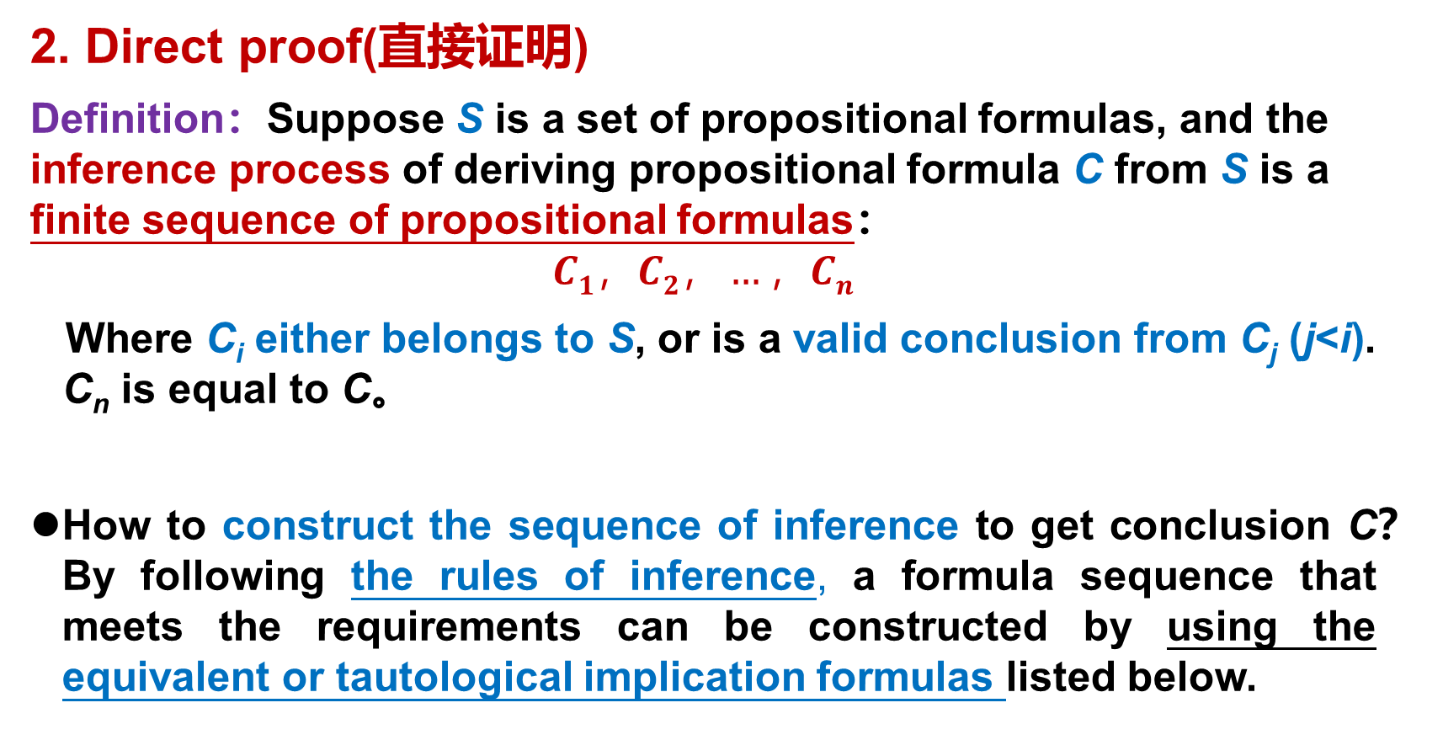
Methods to prove valid conclusion
有效结论
定义
证明方法：
1.真值表法
2.直接证明
推论规则
P、T
CP
3.反证法
F规则
2. Direct proof(直接证明)
Definition：Suppose S is a set of propositional formulas, and the inference process of deriving propositional formula C from S is a finite sequence of propositional formulas：
$$C1，C2，…，Cn$$
Where C_{i} either belongs to S, or is a valid conclusion from C_{j} (j<i). C_{n} is equal to C。
How to construct the sequence of inference to get conclusion C？By following the rules of inference, a formula sequence that meets the requirements can be constructed by using the equivalent or tautological implication formulas listed below.

Slide 14
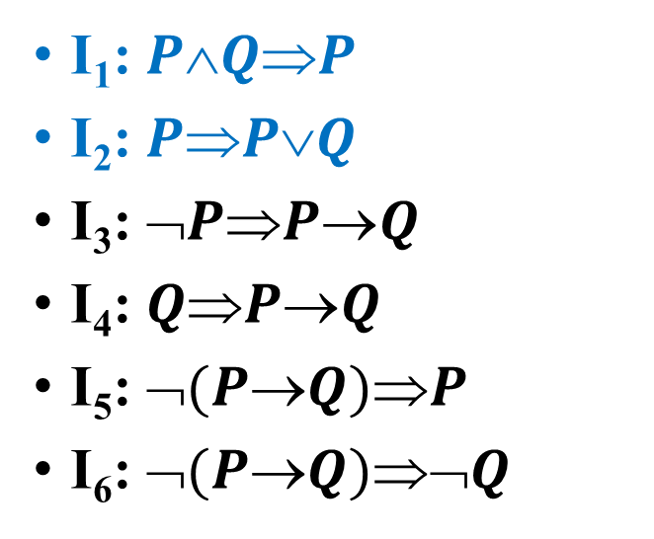
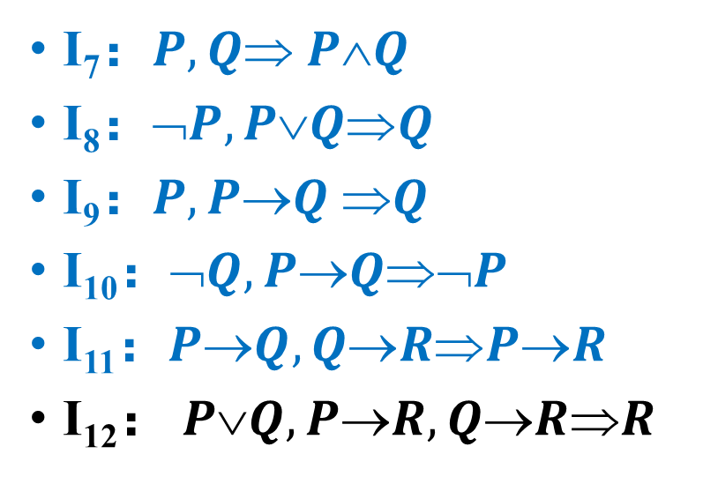
Commonly used implications
有效结论
定义
证明方法：
1.真值表法
2.直接证明
推论规则
P、T
CP
3.反证法
F规则
I₁: $PQP$
I₂: $PPQ$
I₃: $➢PPQ$
I₄: $QPQ$
I₅: $➢(PQ)P$
I₆: $➢(PQ)➢Q$
I₇：$P,Q PQ$
I₈：$➢P,PQQ$
I₉：$P, PQ Q$
I₁₀：$➢Q,PQ➢P$
I₁₁：$PQ,QRPR$
I₁₂： $PQ,PR,QRR$
“,” stands for “∧”.

Slide 15
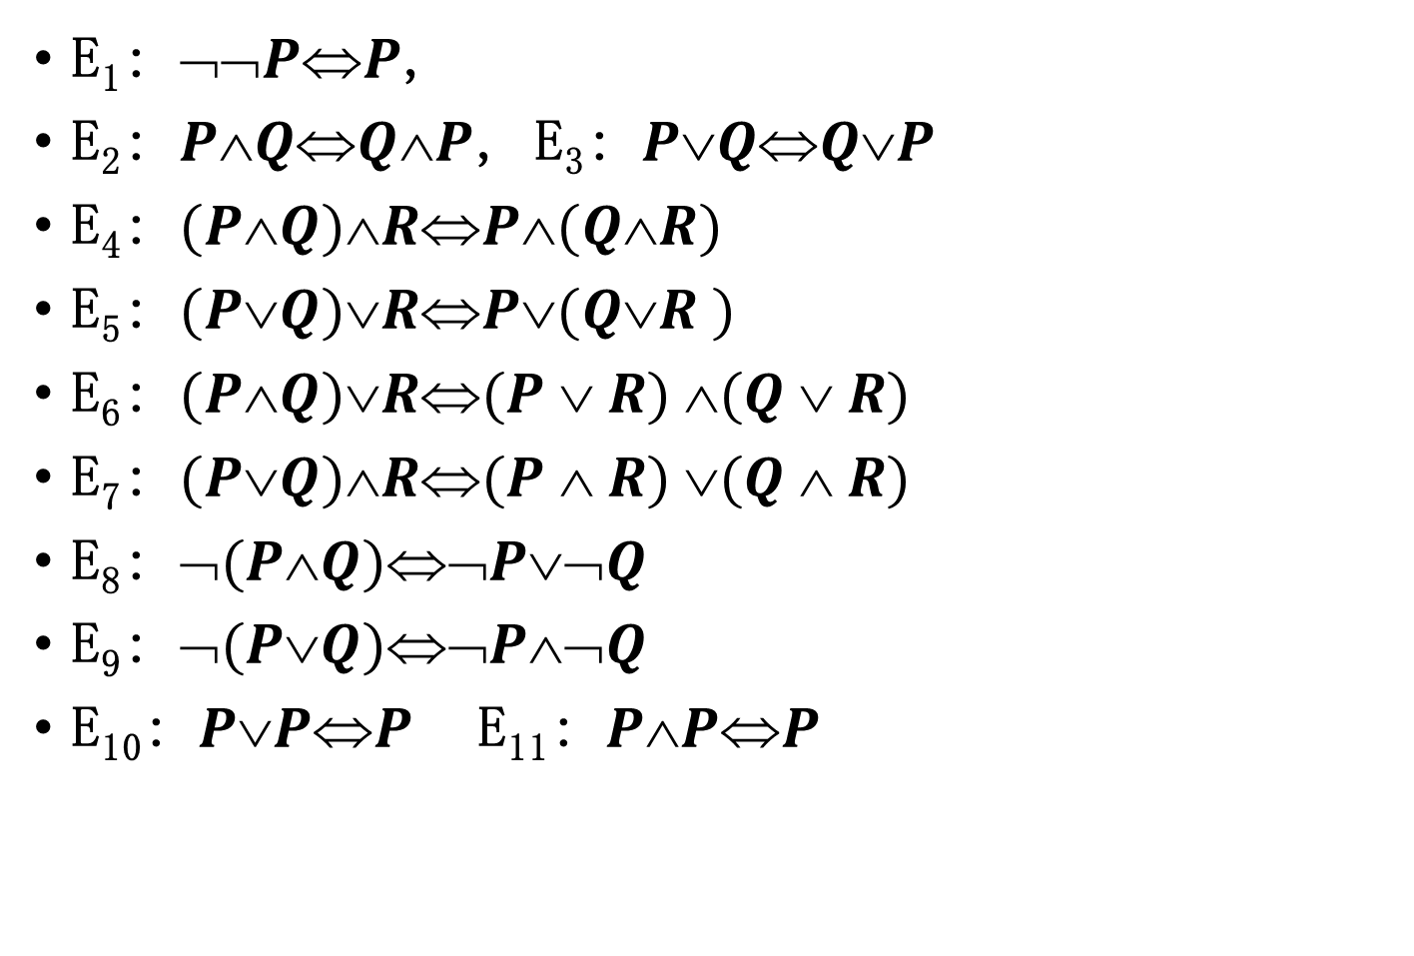
Commonly used equivalences
有效结论
定义
证明方法：
1.真值表法
2.直接证明
推论规则
P、T
CP
3.反证法
F规则
E₁: $➢➢PP$,
E₂: $PQQP$, E₃: $PQQP$
E₄: $(PQ)RP(QR)$
E₅: $(PQ)RP(QR )$
E₆: $(PQ)R(P  R) (Q  R)$
E₇: $(PQ)R(P  R) (Q  R)$
E₈: $➢(PQ)➢P➢Q$
E₉: $➢(PQ)➢P➢Q$
E₁₀: $PPP$E₁₁: $PPP$

Slide 16
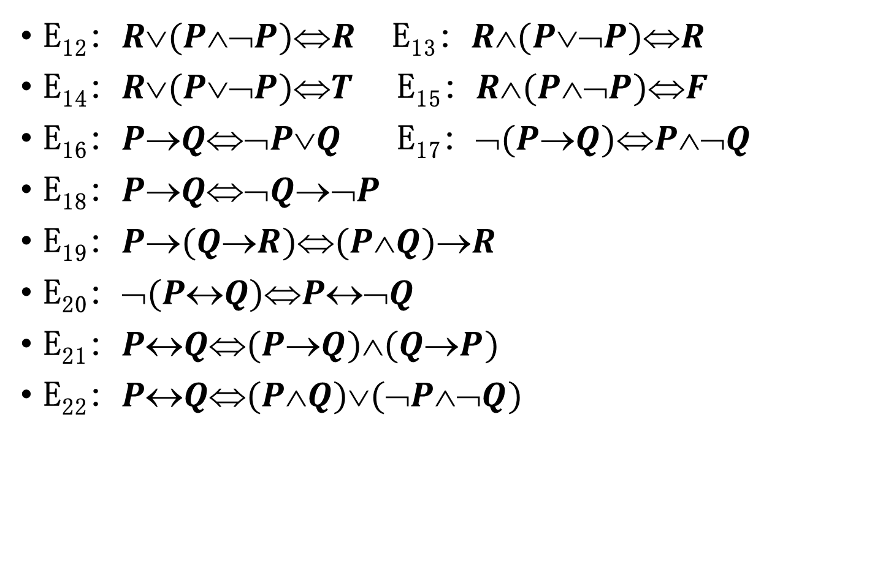
Commonly used equivalences
有效结论
定义
证明方法：
1.真值表法
2.直接证明
推论规则
P、T
CP
3.反证法
F规则
E₁₂: $R(P➢P)R$ E₁₃: $R(P➢P)R$
E₁₄: $R(P➢P)T$ E₁₅: $R(P➢P)F$
E₁₆: $PQ➢PQ$ E₁₇: $➢(PQ)P➢Q$
E₁₈: $PQ➢Q➢P$
E₁₉: $P(QR)(PQ)R$
E₂₀: $➢(PQ)P➢Q$
E₂₁: $PQ(PQ)(QP)$
E₂₂: $PQ(PQ)(➢P➢Q)$

Slide 17
Commonly used equivalences
有效结论
定义
证明方法：
1.真值表法
2.直接证明
推论规则
P、T
CP
3.反证法
F规则

Slide 18
Inference rules in direct proof
有效结论
定义
证明方法：
1.真值表法
2.直接证明
推论规则
P、T
CP
3.反证法
F规则
Inference rules：
Rule P：In proof, the premises can be introduced at any time. Introducing a premise is called using the rule P once.
Rule T：In proof, introducing a formula derived from the tautological implication of the given premises directly or indirectly is called using the rule T once.

Slide 19
Inference rules in direct proof
有效结论
定义
证明方法：
1.真值表法
2.直接证明
推论规则
P、T
CP
3.反证法
F规则
Example： ¬P is the valid conclusion of ¬(P∧¬Q), ¬Q∨R , ¬R
Solution:
{1} (1) ¬(P ∧ ¬Q) P rule
{1} (2) ¬P ∨Q T rule (1) and E₁₁
{1} (3) P→Q T rule (2) and E₂₇
{4} (4) ¬ Q ∨R P rule
{4} (5) Q→R T rule (4) and E₂₇
{1,4} (6) P→R T , (3), (5) and I₁₂
{7} (7) ¬ R P rule
{1,4,7}(8) ¬P T,(6),(7) and I₁₂

Slide 20
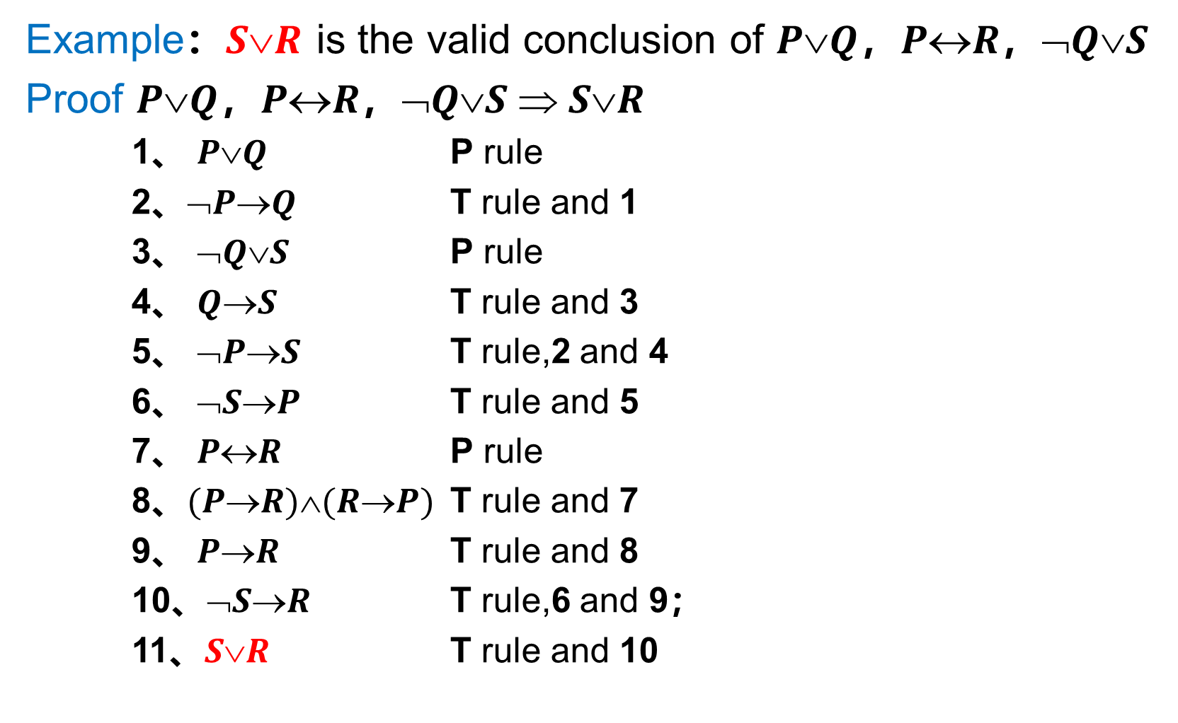
Inference rules in direct proof
有效结论
定义
证明方法：
1.真值表法
2.直接证明
推论规则
P、T
CP
3.反证法
F规则
Example：$SR$ is the valid conclusion of $PQ$，$PR$，$➢QS$
Proof $PQ$，$PR$，$➢QS  SR$
1、 $PQ$ P rule
2、$➢PQ$ T rule and 1
3、 $➢QS$ P rule
4、 $QS$ T rule and 3
5、 $➢PS$ T rule,2 and 4
6、 $➢SP$ T rule and 5
7、 $PR$ P rule
8、$(PR)(RP)$ T rule and 7
9、 $PR$ T rule and 8
10、$➢SR$ T rule,6 and 9；
11、$SR$ T rule and 10

Slide 21
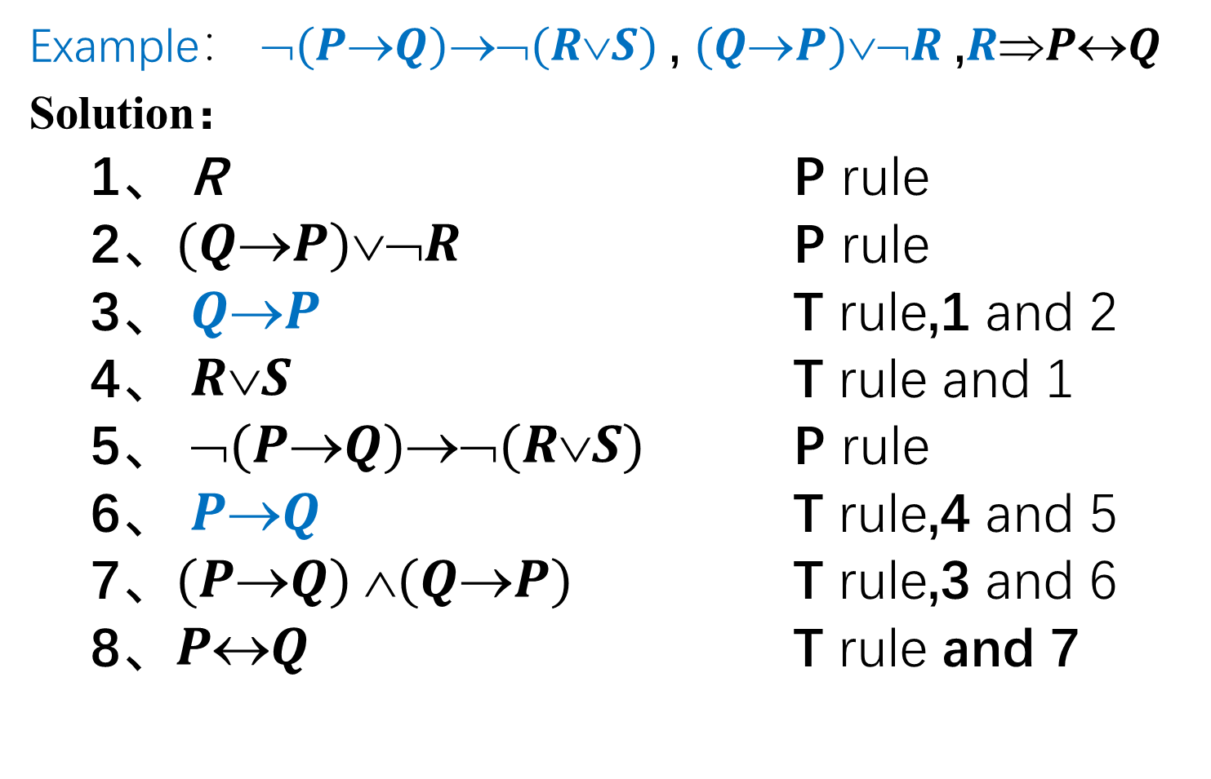
Method of direct proof
有效结论
定义
证明方法：
1.真值表法
2.直接证明
推论规则
P、T
CP
3.反证法
F规则
Example： $➢(PQ)➢(RS)$, $(QP)➢R$,$RPQ$
Solution：
1、 R P rule
2、$(QP)➢R$ P rule
3、 $QP$ T rule,1 and 2
4、 $RS$ T rule and 1
5、 $➢(PQ)➢(RS)$ P rule
6、 $PQ$ T rule,4 and 5
7、$(PQ) (QP)$ T rule,3 and 6
8、$PQ$ T rule and 7

Slide 22
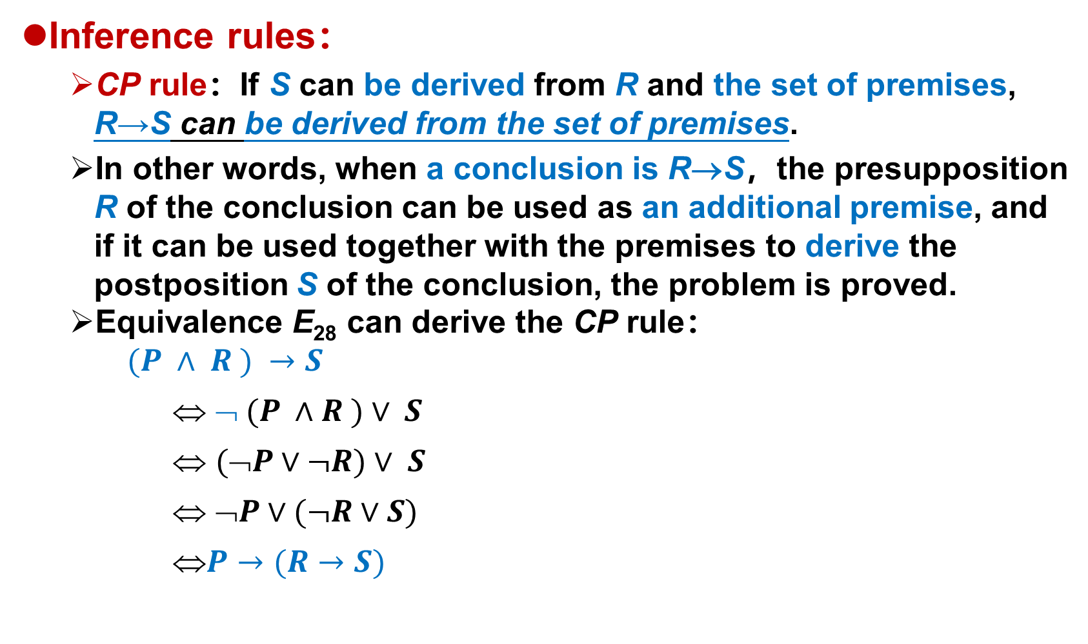
Method of direct proof
有效结论
定义
证明方法：
1.真值表法
2.直接证明
推论规则
P、T
CP
3.反证法
F规则
Inference rules：
CP rule：If S can be derived from R and the set of premises, R→S can be derived from the set of premises.
In other words, when a conclusion is R→S，the presupposition R of the conclusion can be used as an additional premise, and if it can be used together with the premises to derive the postposition S of the conclusion, the problem is proved.
Equivalence E₂₈ can derive the CP rule：
$(P ∧ R ) →S$
⇔ $➢ (P ∧R )∨ S$
⇔ $(➢P∨¬R)∨ S$
⇔ $➢P∨(¬R∨S)$
⇔$P→(R→S)$
Notes:
P：前提集合
R：结论的前件
S：结论的后件

Slide 23
Method of direct proof —— CP rule
有效结论
定义
证明方法：
1.真值表法
2.直接证明
推论规则
P、T
CP
3.反证法
F规则
Example: R →S is the valid conclusion of P→(Q→S), Q, ¬R∨P
Solution：
{1} (1) R P rule (additional premise)
{2} (2) ¬R ∨P P rule
{1,2} (3) P T rule, (1), (2) and I₉
{4} (4) P→(Q→S) P rule
{1,2,4} (5) Q→S T rule, (3), (4) and I₁₀
{6} (6) Q P rule
{1,2,4,6} (7) S T rule, (5), (6) and I₁₀
{1,2,4,6} (8) R →S CP rule, (1), (7)

Slide 24
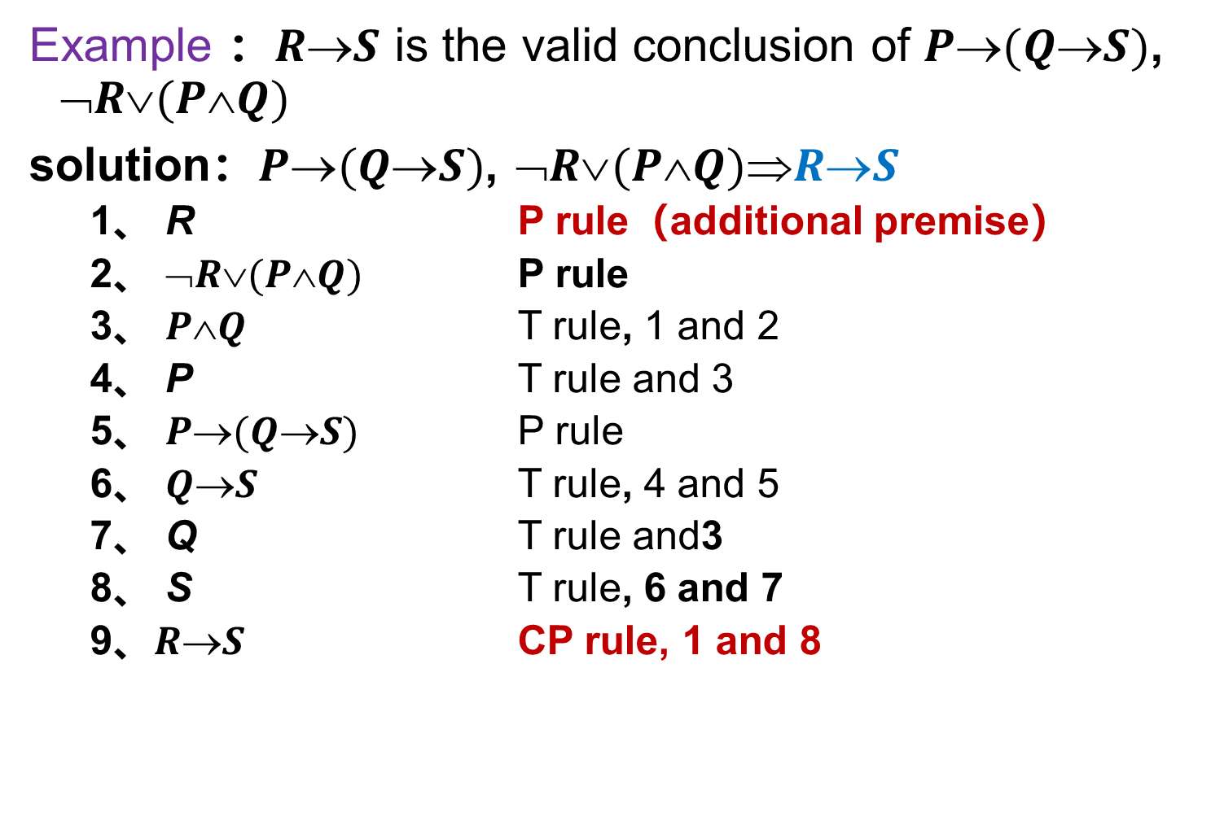
Method of direct proof —— CP rule
有效结论
定义
证明方法：
1.真值表法
2.直接证明
推论规则
P、T
CP
3.反证法
F规则
Example ：$RS$ is the valid conclusion of $P(QS)$, $➢R(PQ)$
solution：$P(QS)$, $➢R(PQ)RS$
1、 R P rule（additional premise）
2、 $➢R(PQ)$ P rule
3、 $PQ$ T rule, 1 and 2
4、 P T rule and 3
5、 $P(QS)$ P rule
6、 $QS$ T rule, 4 and 5
7、 Q T rule and3
8、 S T rule, 6 and 7
9、$RS$ CP rule, 1 and 8

Slide 25
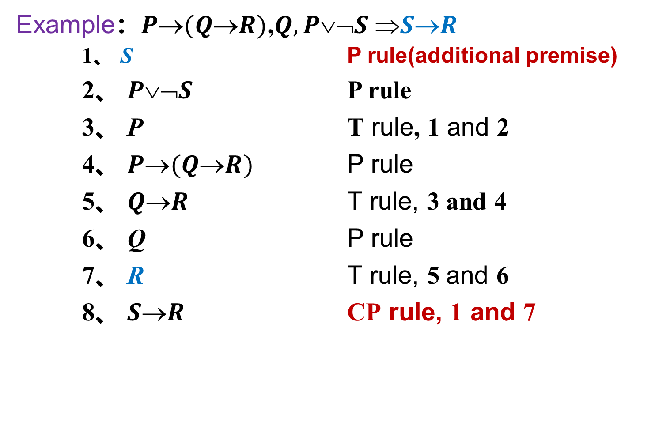
Method of direct proof —— CP rule
有效结论
定义
证明方法：
1.真值表法
2.直接证明
推论规则
P、T
CP
3.反证法
F规则
Example：$P(QR)$,$Q, P➢S SR$
1、 S P rule(additional premise)
2、 $P➢S$ P rule
3、 P T rule, 1 and 2
4、 $P(QR)$ P rule
5、 $QR$ T rule, 3 and 4
6、 Q P rule
7、 R T rule, 5 and 6
8、 $SR$ CP rule, 1 and 7

Slide 26
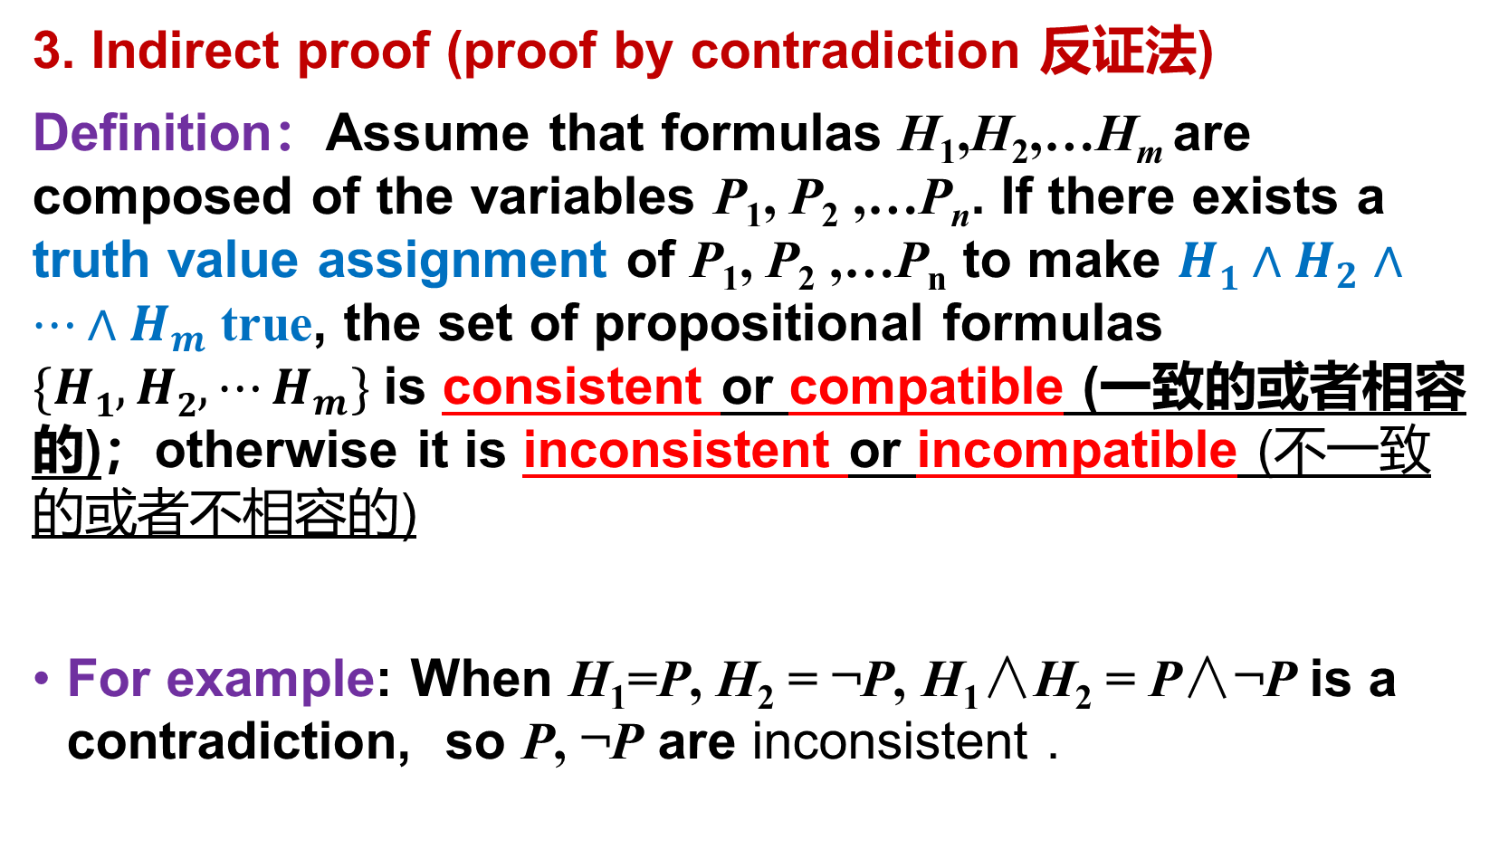
Methods to prove valid conclusions
有效结论
定义
证明方法：
1.真值表法
2.直接证明
推论规则
P、T
CP
3.反证法
F规则
3. Indirect proof (proof by contradiction 反证法)
Definition：Assume that formulas H₁,H₂,…H_{m} are composed of the variables P₁, P₂ ,…P_{n}. If there exists a truth value assignment of P₁, P₂ ,…P_{n} to make $H1∧H_{2}∧⋯∧H_{m}$true, the set of propositional formulas $\{H1,H2,⋯H_{m}\}$is consistent or compatible (一致的或者相容的)；otherwise it is inconsistent or incompatible (不一致的或者不相容的)
For example: When H₁=P, H₂ = ¬P, H₁∧H₂ = P∧¬P is a contradiction, so P, ¬P are inconsistent .

Slide 27
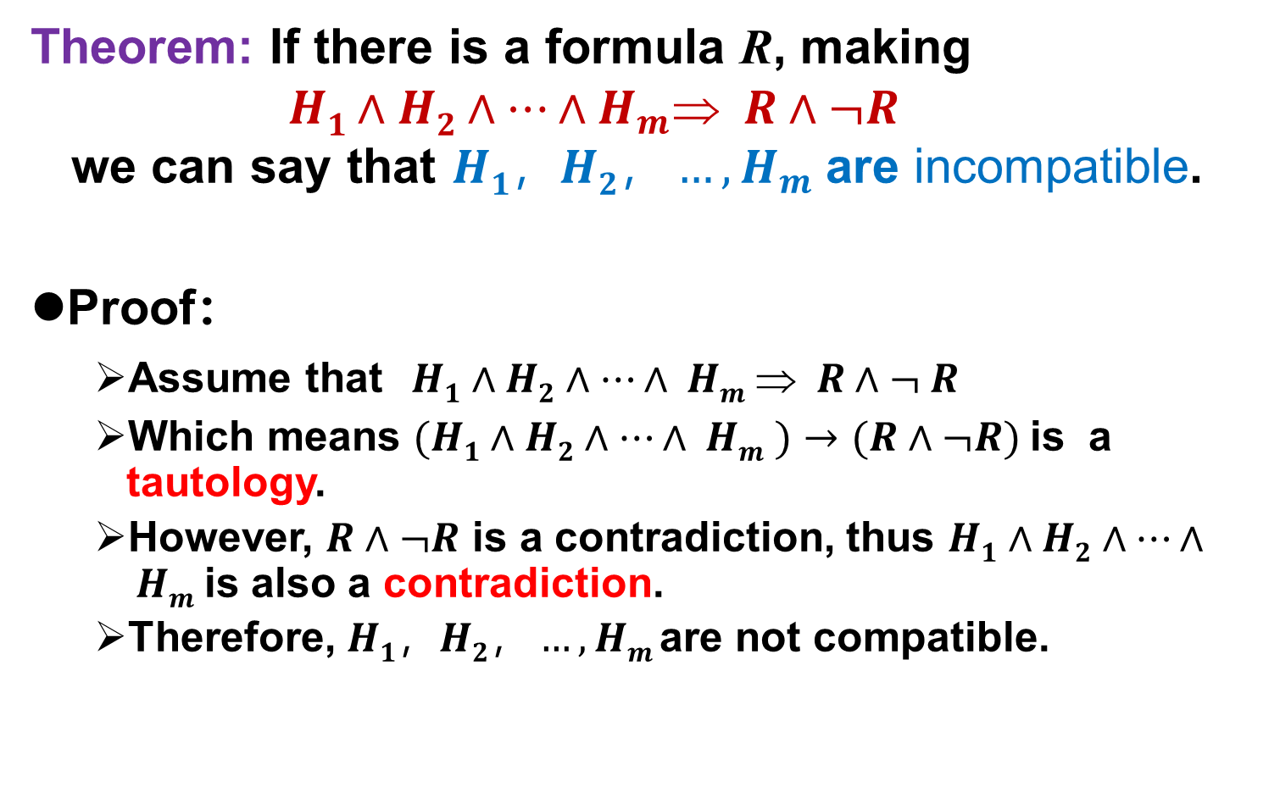
Proof by contradiction
有效结论
定义
证明方法：
1.真值表法
2.直接证明
推论规则
P、T
CP
3.反证法
F规则
Theorem: If there is a formula R, making $H1∧H2∧…∧H_{m} R∧¬R$ we can say that $H1，H2，…,H_{m}$are incompatible.
Proof：
Assume that $H1∧H2∧…∧ Hm  R∧¬ R$
Which means $(H1∧H2∧…∧ Hm )→(R∧¬R)$is a tautology.
However, $R∧¬R$ is a contradiction, thus $H1∧H2∧…∧ Hm$is also a contradiction.
Therefore, $H1，H2，…,Hm$are not compatible.

Slide 28
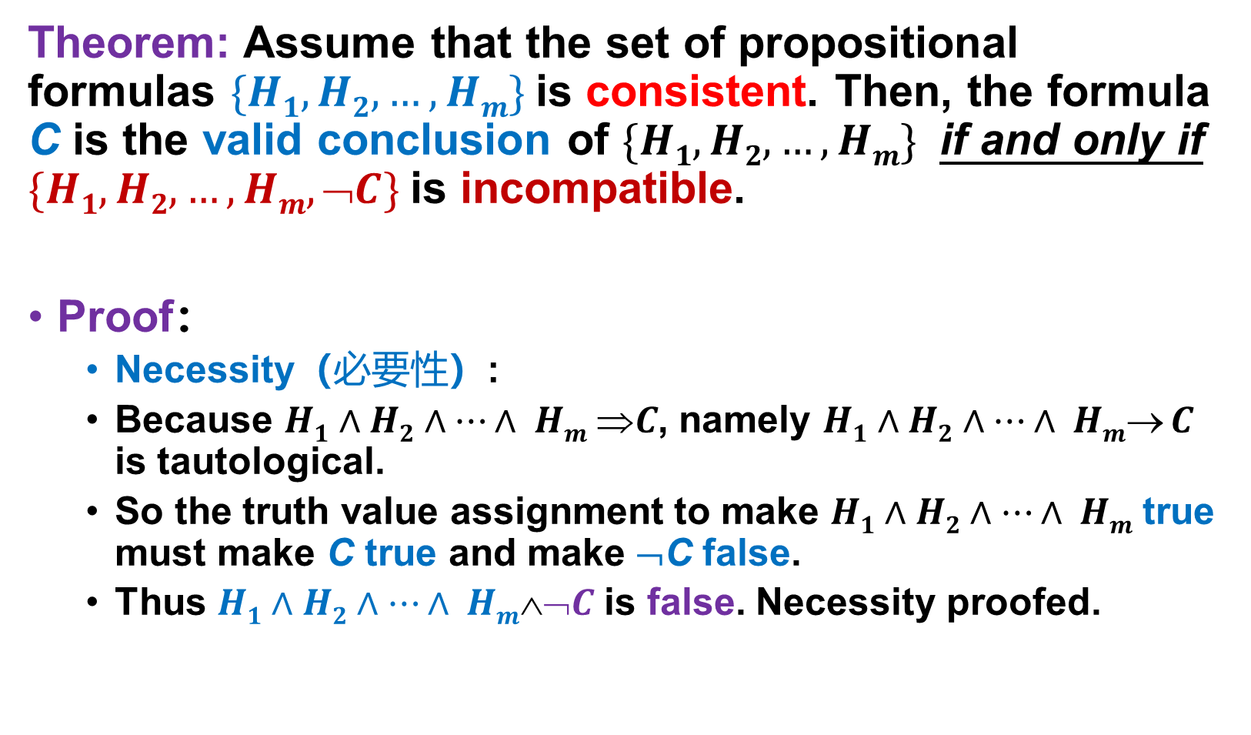
Proof by contradiction
有效结论
定义
证明方法：
1.真值表法
2.直接证明
推论规则
P、T
CP
3.反证法
F规则
Theorem: Assume that the set of propositional formulas $\{H1,H2,…,Hm\}$is consistent. Then, the formula C is the valid conclusion of $\{H1,H2,…,Hm\}$ if and only if $\{H1,H2,…,Hm,➢C\}$is incompatible.
Proof：
Necessity（必要性）:
Because $H1∧H2∧…∧ Hm C$, namely $H1∧H2∧…∧ Hm C$ is tautological.
So the truth value assignment to make $H1∧H2∧…∧ Hm$true must make C true and make ¬C false.
Thus $H1∧H2∧…∧ Hm➢C$is false. Necessity proofed.
Notes:
P当且仅当q，其中q是条件。
充分性：q->p
必要性：p->q

Slide 29
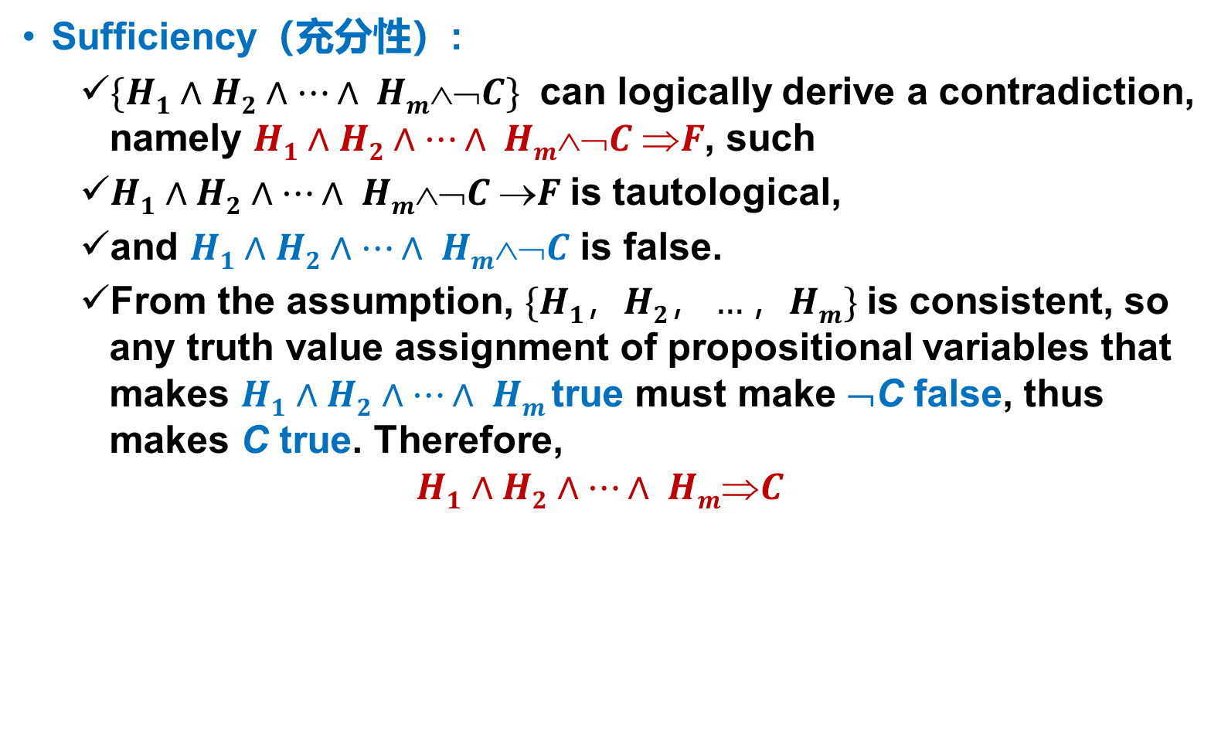
Proof by contradiction
有效结论
定义
证明方法：
1.真值表法
2.直接证明
推论规则
P、T
CP
3.反证法
F规则
Sufficiency（充分性）:
$\{H1∧H2∧…∧ Hm➢C\}$ can logically derive a contradiction, namely $H1∧H2∧…∧ Hm➢C F$, such
$H1∧H2∧…∧ Hm➢C F$is tautological,
and $H1∧H2∧…∧ Hm➢C$ is false.
From the assumption, $\{H1，H2，…，Hm\}$is consistent, so any truth value assignment of propositional variables that makes $H1∧H2∧…∧ Hm$true must make ¬C false, thus makes C true. Therefore,
$$H1∧H2∧…∧ HmC$$

Slide 30
Proof by contradiction
有效结论
定义
证明方法：
1.真值表法
2.直接证明
推论规则
P、T
CP
3.反证法
F规则
This theorem illustrates that the conclusion proved by method of direct proof can also be proved by method of indirect proof and vice versa.
Thus, to prove that B is the conclusion of A, both A and ¬B can be regarded as the premises, if a contradiction can be derived, the problem is proved.
F rule: If the set of premises and ¬S are not compatible, S can be derived from the premise set.

Slide 31
Proof by contradiction
有效结论
定义
证明方法：
1.真值表法
2.直接证明
推论规则
P、T
CP
3.反证法
F规则
Example: ¬(P∧Q) is the valid conclusion of ¬P∧¬Q.
Solution: Take ¬ ¬(P∧Q) as a hypothetical premise, and reach a contradiction.
{1} (1) ¬ ¬(P∧Q) P rule (hypothetical premise)
{1} (2) P∧Q T rule,(1) and E₁₀
{1} (3) P T rule, (2) and I₁
{4} (4) ¬P∧¬Q P rule
{4} (5) ¬P T rule,(4) and I₁
{1,4}(6) P∧ ¬P T rule,(3),(5) and I₁₆
{1,4}(7) ¬(P∧Q) F rule,(1),(6)

Slide 32
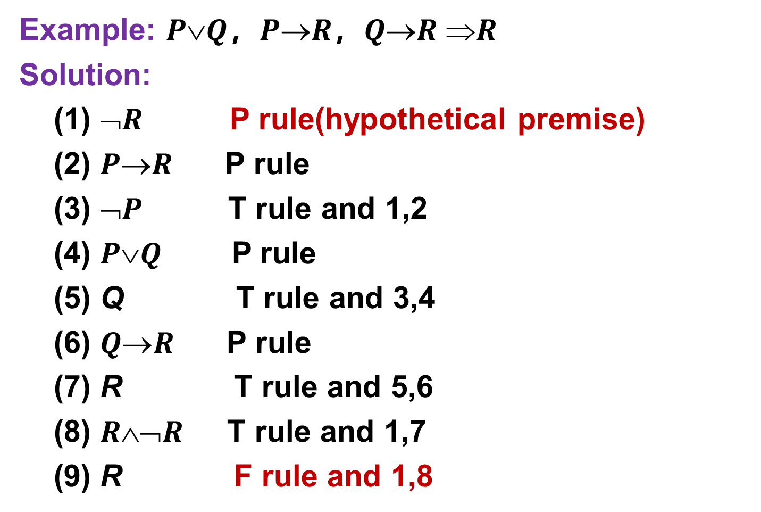
Proof by contradiction
有效结论
定义
证明方法：
1.真值表法
2.直接证明
推论规则
P、T
CP
3.反证法
F规则
Example: $PQ$，$PR$，$QR R$
Solution:
(1) $➢R$ P rule(hypothetical premise)
(2) $PR$ P rule
(3) $➢P$ T rule and 1,2
(4) $PQ$ P rule
(5) Q T rule and 3,4
(6) $QR$ P rule
(7) R T rule and 5,6
(8) $R➢R$ T rule and 1,7
(9) R F rule and 1,8

Slide 33
Proof by contradiction
有效结论
定义
证明方法：
1.真值表法
2.直接证明
推论规则
P、T
CP
3.反证法
Example 3： Four first-class basketball teams in CBA have played several games. The known information is as follows ：
The premises ：
1、若辽宁男篮获冠军，则深圳男篮和浙江广厦男篮获得亚军
2、若深圳男篮获亚军，则辽宁男篮不能获冠军
3、若广东男篮获亚军，则浙江广厦不能获亚军
4、最后辽宁男篮获冠军
The conclusion ：5、广东男篮未获亚军

Slide 34
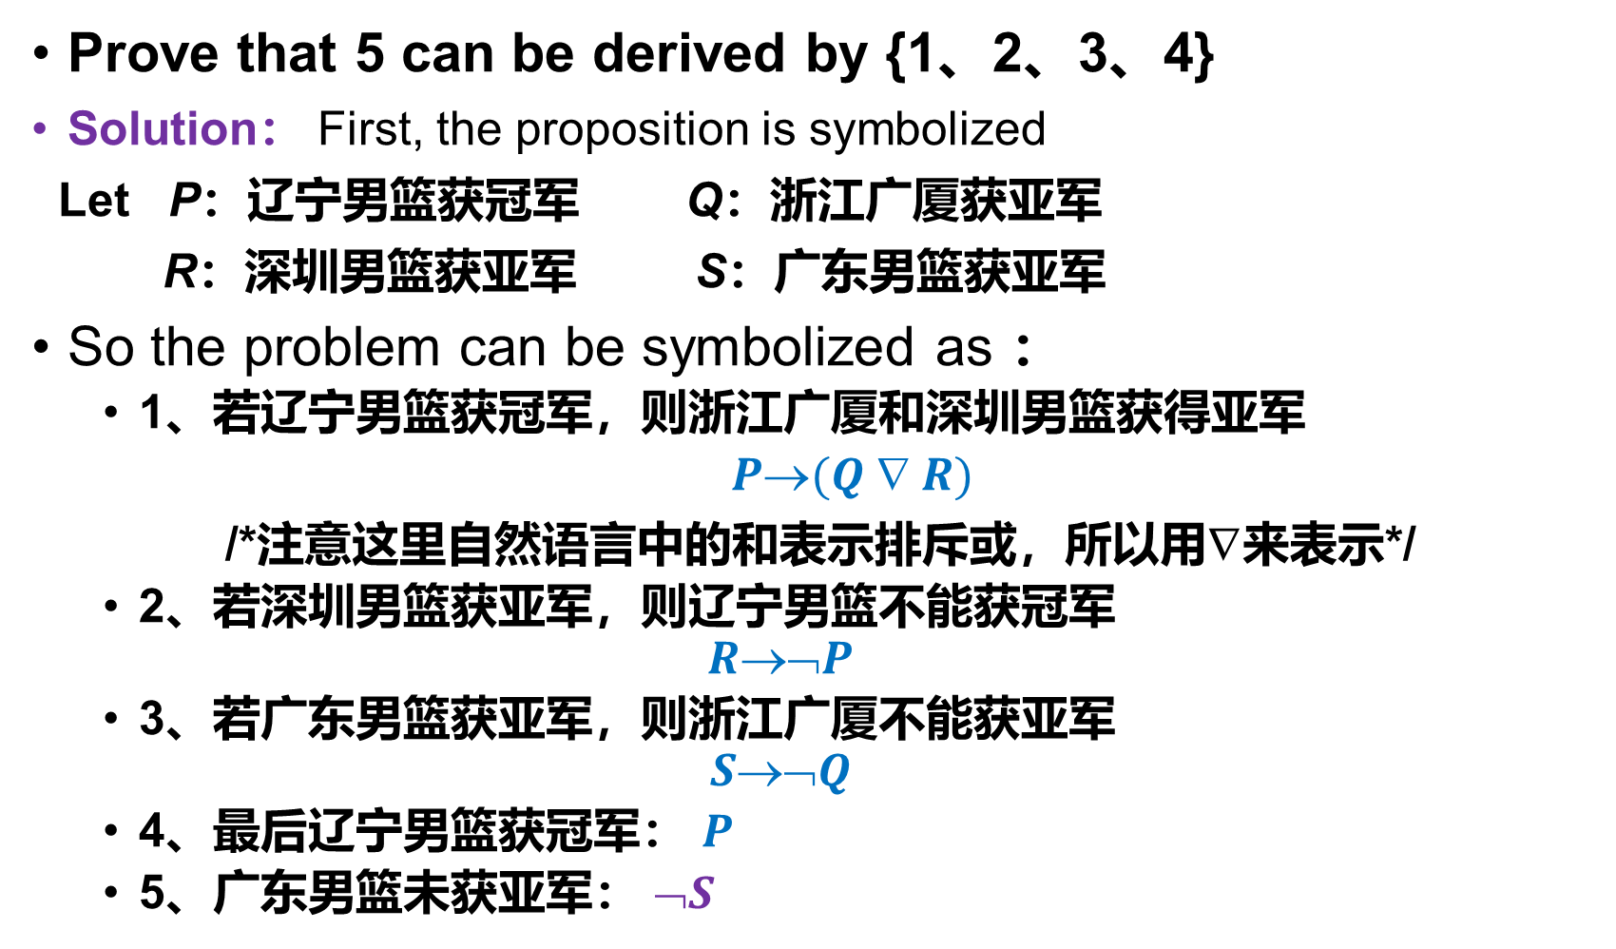
Proof by contradiction
有效结论
定义
证明方法：
1.真值表法
2.直接证明
推论规则
P、T
CP
3.反证法
Prove that 5 can be derived by {1、2、3、4}
Solution： First, the proposition is symbolized
Let P：辽宁男篮获冠军 Q：浙江广厦获亚军
R：深圳男篮获亚军 S：广东男篮获亚军
So the problem can be symbolized as ：
1、若辽宁男篮获冠军，则浙江广厦和深圳男篮获得亚军
$P(Q  R)$
/*注意这里自然语言中的和表示排斥或，所以用∇来表示*/
2、若深圳男篮获亚军，则辽宁男篮不能获冠军
$$R➢P$$
3、若广东男篮获亚军，则浙江广厦不能获亚军
$$S➢Q$$
4、最后辽宁男篮获冠军： $P$
5、广东男篮未获亚军： $➢S$

Slide 35
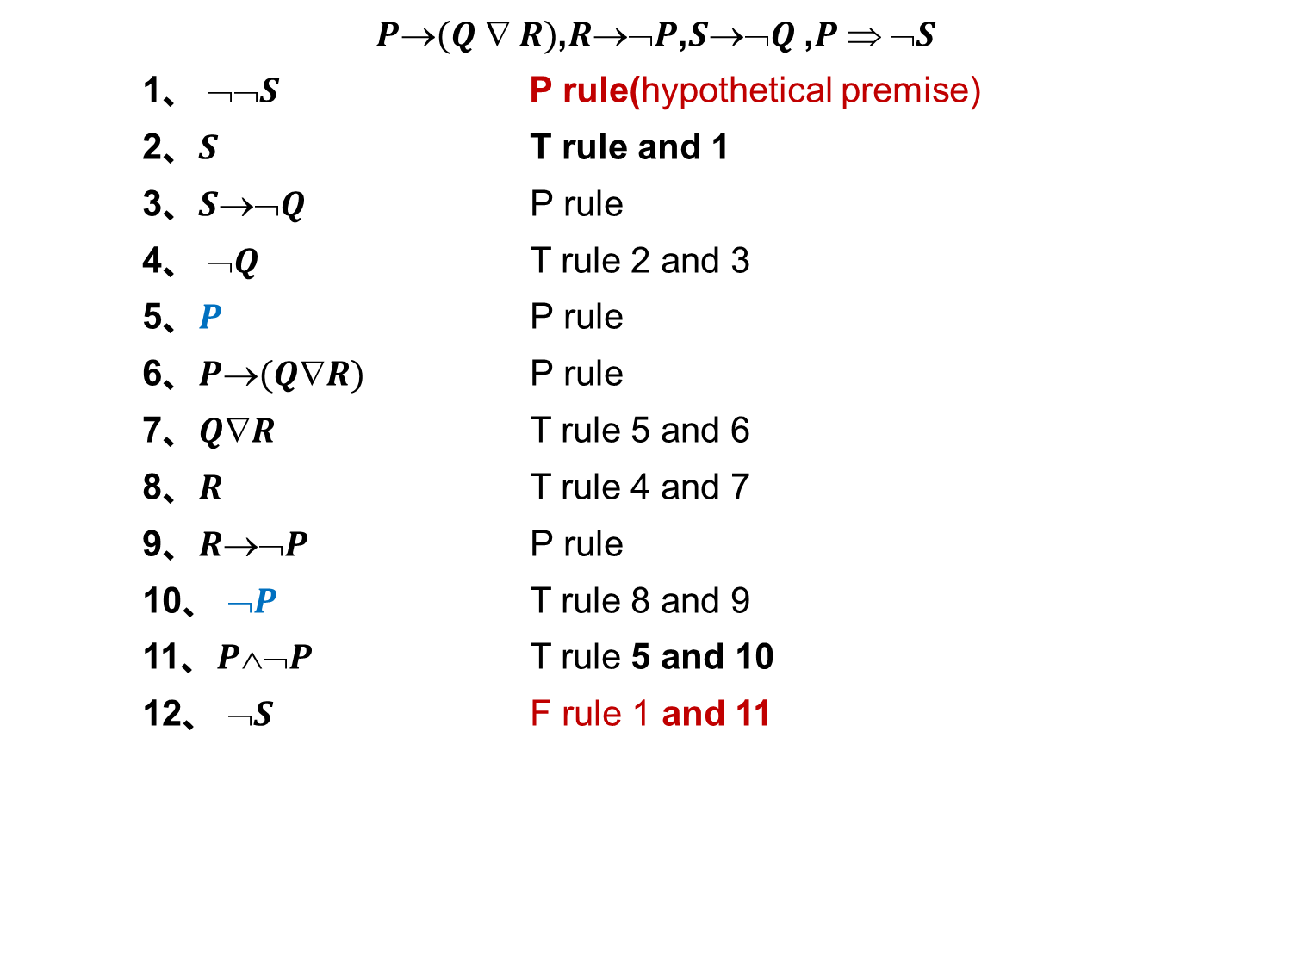
Proof by contradiction
有效结论
定义
证明方法：
1.真值表法
2.直接证明
推论规则
P、T
CP
3.反证法
$P(Q  R)$,$R➢P$,$S➢Q$,$P  ➢S$
1、 $➢➢S$ P rule(hypothetical premise)
2、$S$ T rule and 1
3、$S➢Q$ P rule
4、 $➢Q$ T rule 2 and 3
5、$P$ P rule
6、$P(QR)$ P rule
7、$QR$ T rule 5 and 6
8、$R$ T rule 4 and 7
9、$R➢P$ P rule
10、 $➢P$ T rule 8 and 9
11、$P➢P$ T rule 5 and 10
12、 $➢S$ F rule 1 and 11

Slide 36
Disciplines
Disciplines to use the methods for prove valid conclusions
When the conclusion to be proved is a conditional statement (条件式) , the CP rule can be considered.
When the conclusion to be proved is simple, and it is not obvious when only using the premises to inferring, the F rule can be considered.

Slide 37
Summarization
In this chapter we learn the concept of propositions and logical connectives on sets of propositions:
¬、∧、∨、→、↔、 ∇
However, these logical connectives are not necessary, which leads to the concept of the minimum complete set of logical connectives:
{¬，∧} and {¬，∨}。

Slide 38
Summarization
In addition, we have accomplished an important task in propositional logic:
The methods for determining compound formulas:
A：Truth table；
B：Equivalent formula transformation；
C：Using the duality principle;
D：By solving principal normal form.
We have learned some commonly used equivalence and tautological implication and inference rules to solve reasoning problems；We have introduced P rule, T rule, CP rule, and F rule.

Slide 39
Learning requirements of this chapter
掌握命题、命题联结词及简单命题的符号化；
理解命题变元、命题公式及其真值表；
掌握永真式、矛盾式与可满足式及其判定
熟记等价式与基本等价式，代入规则与替换规则；
掌握范式与主范式及其求解方法；理解主范式的用途与应用；
掌握推理的形式结构及证明方法。
Practice more and more

Slide 40
Homework
P29:
19、20、22、23(1,2,4)、24(1,3)
Coding Practice：
Input a disjunctive normal form, compute and output its principal disjunctive normal form
(optional) Input a propositional formula arbitrarily, calculate and output its truth table as well as the principal disjunctive and conjunctive normal form.

Slide 41

The End
Thanks

